Slide 1
Collaborative Filtering
Group 4:
Mingyue Kong
Nicole Alyse Smith
Noah Chasek-Macfoy
Judy Jinhui Cheng
Yun Li

Slide 2
Table of Contents
1
Project Introduction
2
3
Selecting Neighbors
4
5
Leftovers
Memory Based Performance
Model Based Performance

Slide 3
1. Project Introduction
Traditional
sales model
Web Data
Train: 4151* 269
Test: 665 * 269
Data Processing
Memory Based
Mixed
systems
Collaborative Filtering
Lack of
real-time
feedback
Movie Data
Train: 5055 * 1619
Test: 5055 * 1597
Selecting Neighbors
Model Based

Slide 4
2. Memory Based Performance
1
2
3
4
5
Pearson
Spearman
Vector(cosine)
Mean Square
SimRank
Similarity Weighting Comparison:
 |  | Pearson | Spearman | Vector | Mean Square | SimRank
Rank Score | MS | 37.5723 | 37.5723 | 37.8173 | 45625.77?* | /
MAE | Movie | 1.085 | 1.085 | 1.095303 | 326.54?* | 1.0497
Run time | MS | 0.76h | 0.70h | 0.62h | 2.7h | /
 | Movie | 1.75h | 2.28h | 1.5h | (1000 rows) 1.5h | (1000 rows) over 8h
*: need further analysis

Slide 5
3.1 Selecting Neighbors
Idea: which other users’ data to use in the prediction for a user.
Neighboring improves
accuracy, as high correlates can be exceptionally more valuable as predictors, and
computational time, as commercial collaborative filtering has millions of users and cannot consider all possible combinations of users.

Slide 6
3.2 Selecting Neighbors
There are two methods for selecting neighbors:
Correlation-thresholding: Set an absolute threshold, where all neighbors with correlations above a given threshold are selected.
Advantages: A high threshold produces high correlates
Disadvantages: A high threshold gives you a small neighborhood that limits prediction coverage for many items.
Top-n-neighbors: Pick the best n correlates for a given n.
Advantages: Choosing n does not limit prediction coverage, whereas the threshold approach does.
Disadvantages: High n will result in noise(many low correlates) for users who have high correlates; picking a low n will result in poor prediction for users who do not have many high correlates.

Slide 7
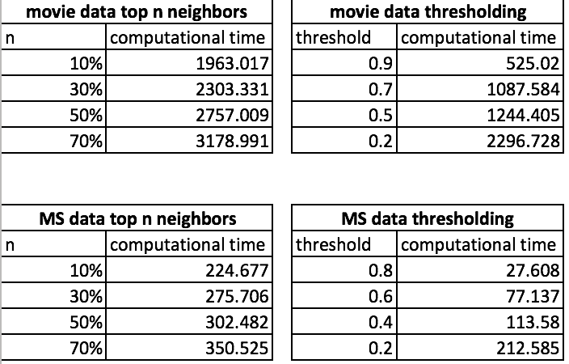
3.3 Selecting Neighbors
Results
Future considerations:
We could combine the two methods, i.e. combining a low threshold with a high n or a high threshold with a low n.

Slide 8
4.1 Model Based Process
1
2
3
4
5
Step 1
Step 2
Step 3
Step 4
Step 5
Review mathematics behind EM Algorithm
Initialize parameters
Write expectation step of EM algorithm
Write maximization step of EM algorithm
Create hard assignments

Slide 9
4.2 Model Based Performance
We had to initialize at random points to get any movement between iterations in EM algorithm
Variation between clusters for predicted ratings for movie j start out very small (0.009655562 in one case after 3 iterations) and diverge over time
Distribution of the users over the clusters also diverges over time, after 3 iterations we have ~64% of all users in a single cluster
In 4 iterations the L-2 norm of change between iterations went from ~3.5 to ~.2, it must have some kind of exponential decay convergence if it takes so long to get from .2 to .01
Fun fact: apparently you can subset cells of a matrix with a 2 col matrix of coordinates in the extract brackets
Graph ideas: convergence over time, histogram of predicted ratings

Slide 10
4.3 Details of Model Based Performance
Model Results
Tau: L-2 norm of difference between soft assignment matrices from two consecutive iterations.
We used a threshold of .01 for convergence…
Movie data never reached convergence threshold, possibly because it has so many more dimensions than that MS data.
Thus, tau is likely not directly comparable between data sets.

Slide 11
4.3 Details of Model Based Performance
Movie Data - max iterations: 750; clusters: 12
Final Tau: 0.0115
Total iterations: 750
Elapsed Time: 8.16 hours !!
Cluster Distribution: 88% in group 11, 10% in group 4… the rest are below 1%
MAE Score: 1.107312

Slide 12
Movie Data - max iterations: 750; clusters: 12
4.3 Details of Model Based Performance
Notes:
There was an bug in the EM clustering function when we trained this model; we were calculating gamma (probability of user i rating movie j with rating k) by dividing by all movies rather than all movies rated by user i.
88% of users in group 11 corresponded to mu (probability of being in cluster c) of 14% for group 11. How do we interpret this?

Slide 13
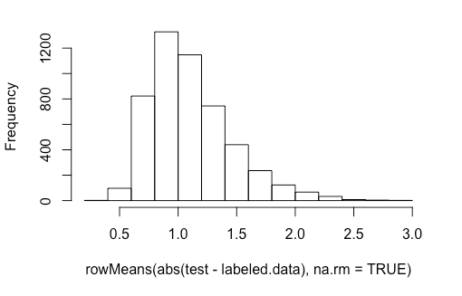
4.3 Details of Model Based Performance
Histogram of individual user MAE scores

Slide 14
Movie Data - max iterations: 100; clusters: 10
4.3 Details of Model Based Performance
Final Tau: 0.02726874
Total iterations: 99
Elapsed Time: lost to history, but approx. 1 hr
Distribution over clusters: 96% in cluster 2
MAE Score: 1.107282

Slide 15
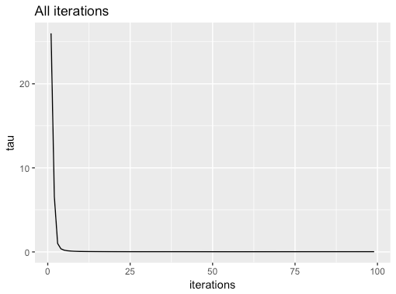
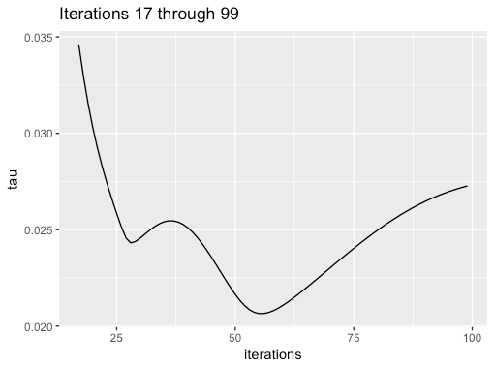
4.3 Details of Model Based Performance
Tau convergence over time

Slide 16
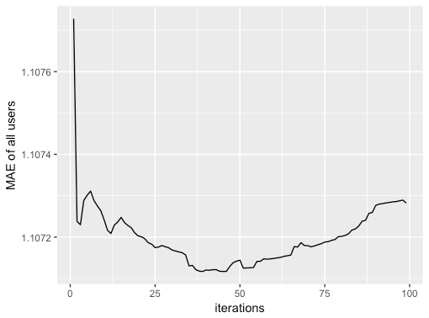
MAE over time
4.3 Details of Model Based Performance

Slide 17
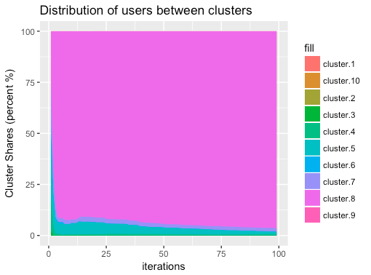
Cluster Distribution over time
4.3 Details of Model Based Performance

Slide 18
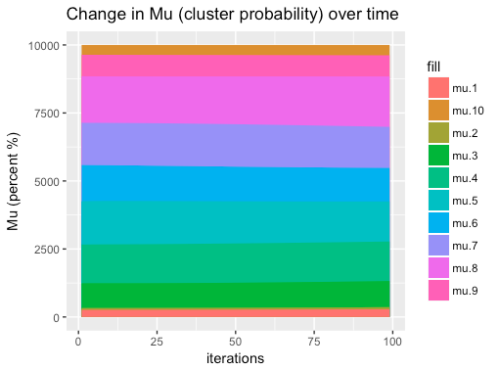
4.3 Details of Model Based Performance

Slide 19
4.3 Details of Model Based Performance
Virtually no improvement or even variation in MAE over time. Never below 1.
Tau improves early on, but is virtually constant soon after
Cluster distribution suggests our algorithm is optimizing to cluster every user in a single group
Compare tau convergence and cluster distribution over time
Virtually no movement in Mu
Something is not right here...

Slide 20
MS Data - max iterations: 700; clusters: 10
4.3 Details of Model Based Performance
Final Tau: 1.151118e-13
Total iterations: 700
Elapsed Time: 0.34 hours
Distribution over clusters: 92% in group 6
Expected Utility Score: 47.99079

Slide 21
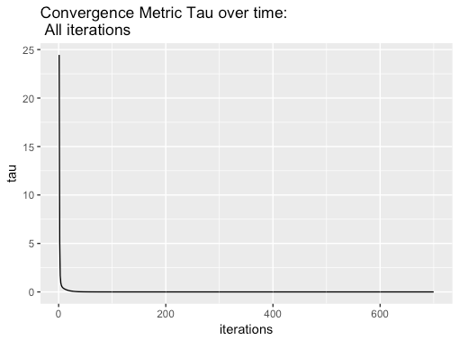
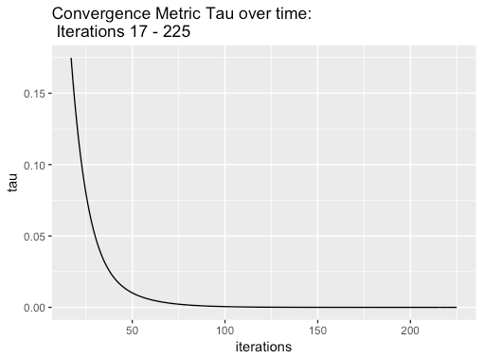
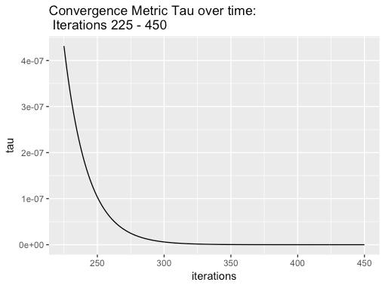
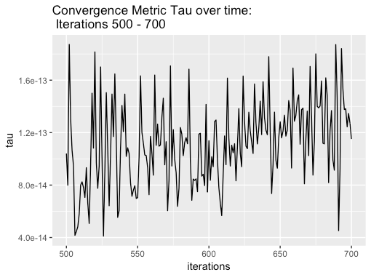
4.3 Details of Model Based Performance

Slide 22
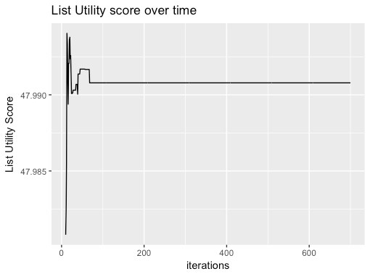
4.3 Details of Model Based Performance

Slide 23
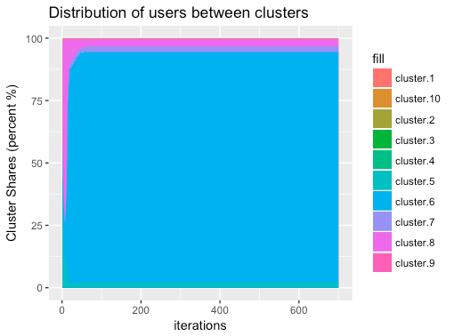
4.3 Details of Model Based Performance

Slide 24
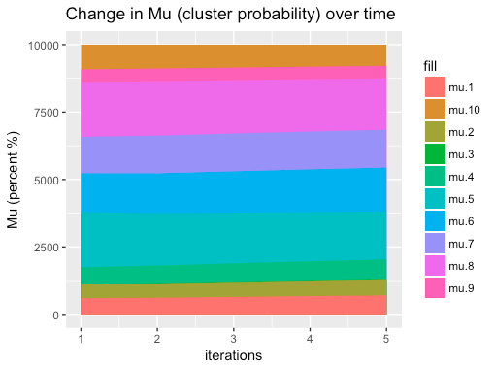
4.3 Details of Model Based Performance

Slide 25
MS Data - max iterations: 700; clusters: 10
4.3 Details of Model Based Performance
Much, much faster computationally than movie model training. Probably because of the fewer users, items, and rating levels.
The fact that both data sets grouped most users into the same cluster suggests the problem is with our algorithm
Pretty much no convergence after 200 iterations
The entire range of List Utility scores is between 47.77052 and 47.99538. It seemingly randomly starts at the low end and stabilizes within 30 iterations.
What does it mean that tau continued to converge after the Utility score stabilized?
Why does Mu stay pretty much unchanged through the iterations, but the cluster distributions converge?

Slide 26
5. Leftovers
Process
We spent a lot of understanding the math behind collaborative filtering.
Improvements
Model-based: Minimize number of loops in the EM algorithm to improve computational time.
Model-based: Use cross-validation.

Slide 27
Thank you!
Group 4:
Mingyue Kong
Nicole Alyse Smith
Noah Chasek-Macfoy
Judy Jinhui Cheng
Yun Li

